Slide 1
Rescue-feet
User Controlled Hexapod with Live stream for rescue operations
Archit Sharma, Sai Pranay, Samyu Kamtam

Slide 2
Contents
Problem statement
Features
Advantages and disadvantages
Design
System flow chart
Mathematics
Hexapod integration
Prototype
Practical Overview
Related work
Applications
Innovative features and Unique selling proposition
Cost analysis
Next steps and Conclusion

Slide 3
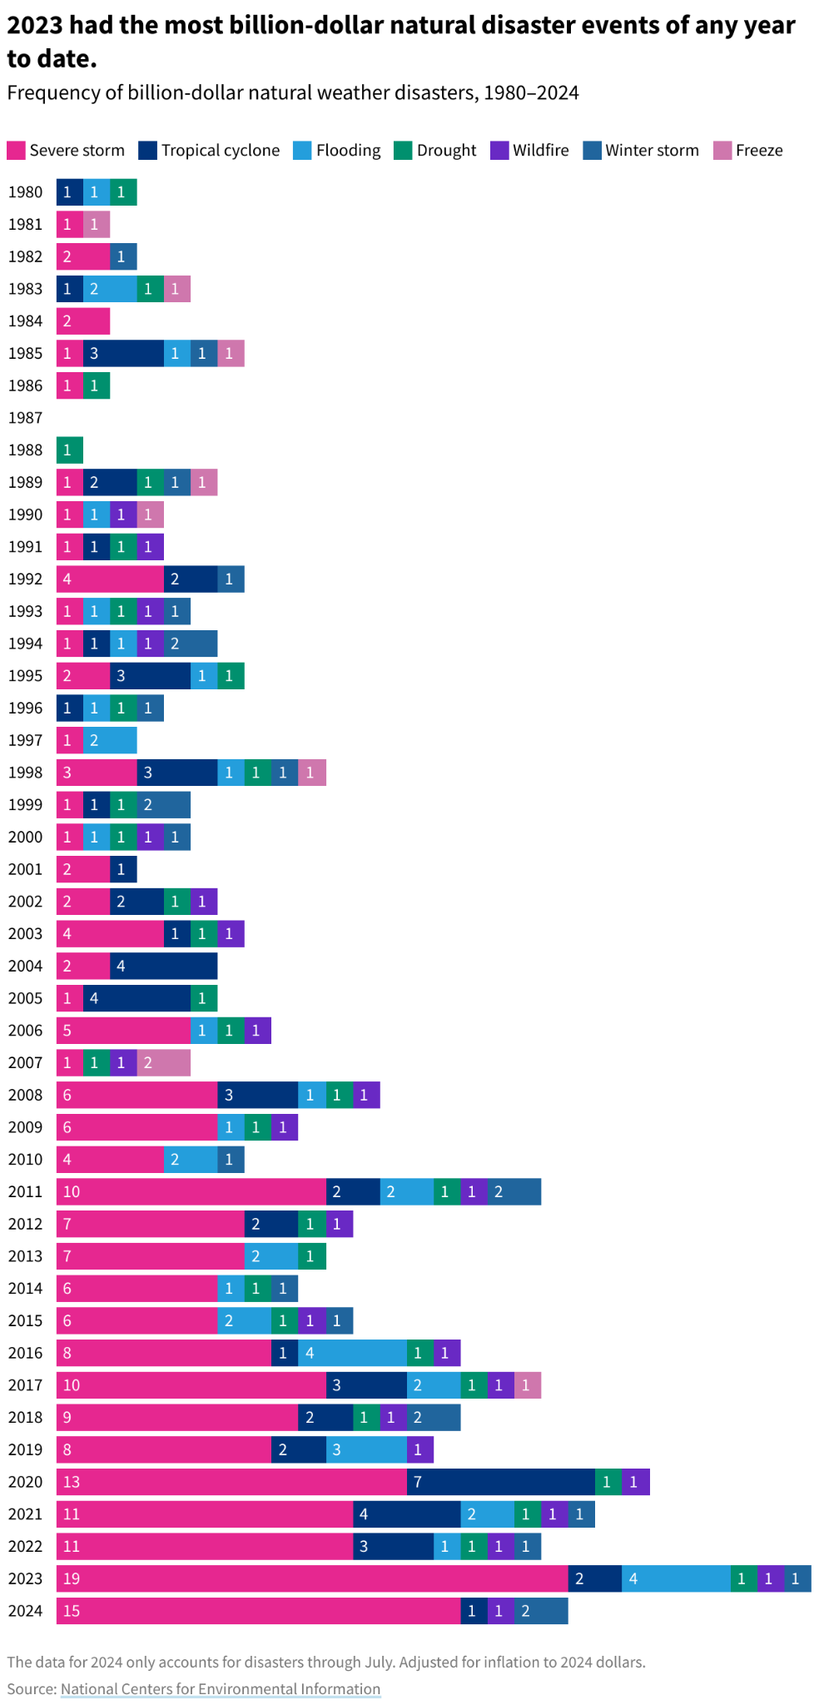
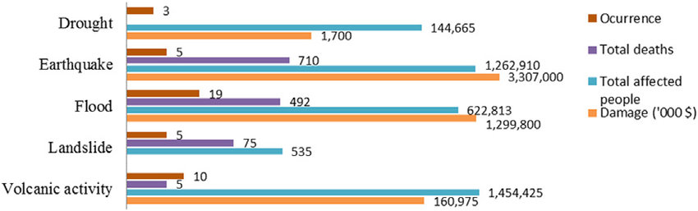
Problem Statement
The increasing frequency and severity of natural disasters make traditional search-and-rescue operations challenging due to hazardous conditions and inaccessible terrain.
Rescue robots provide a critical solution by enhancing response efforts, navigating dangerous environments, and locating survivors more efficiently, ultimately improving disaster relief and saving lives.

Slide 4
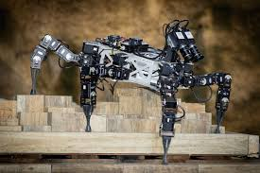
Features
Six-legged locomotion provides stability in rough terrain navigation
Keyboard control for remote operation
Real-time video streaming with ESP32-CAM
Modular design for flexibility and upgrades

Slide 5
Safety features and instructions

Slide 6
Advantages
Disadvantages
Enhanced mobility
Remote controlled operation
Stability and redundancy
Real time video streaming
Modular & scalable design
Complexity (Design and control)
Cost
Energy consumption
Connectivity issue
Payload limitations

Slide 7
Design

Slide 8
Working
Actuate
Servo states outputted as PWM signals to servos for actuation.
03
Sense (peripherals)
Using camera live stream to view the scene of the disaster.
01
02
Controls
User controls hexapod through computer keyboard and sends signal to arduino through bluetooth module.

Slide 9





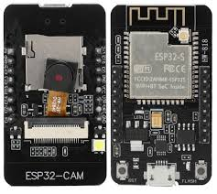
System flow chart
User-control
Python script for navigation input
Arduino
Gait calculation for servo control
Via Bluetooth
BS-2
Power regulator for Arduino and ESP-32
Hexapod
Hexapod locomotion with appropriate servo movement.
Esp-32
Live stream of hexapod view for accurate navigation.

Slide 10
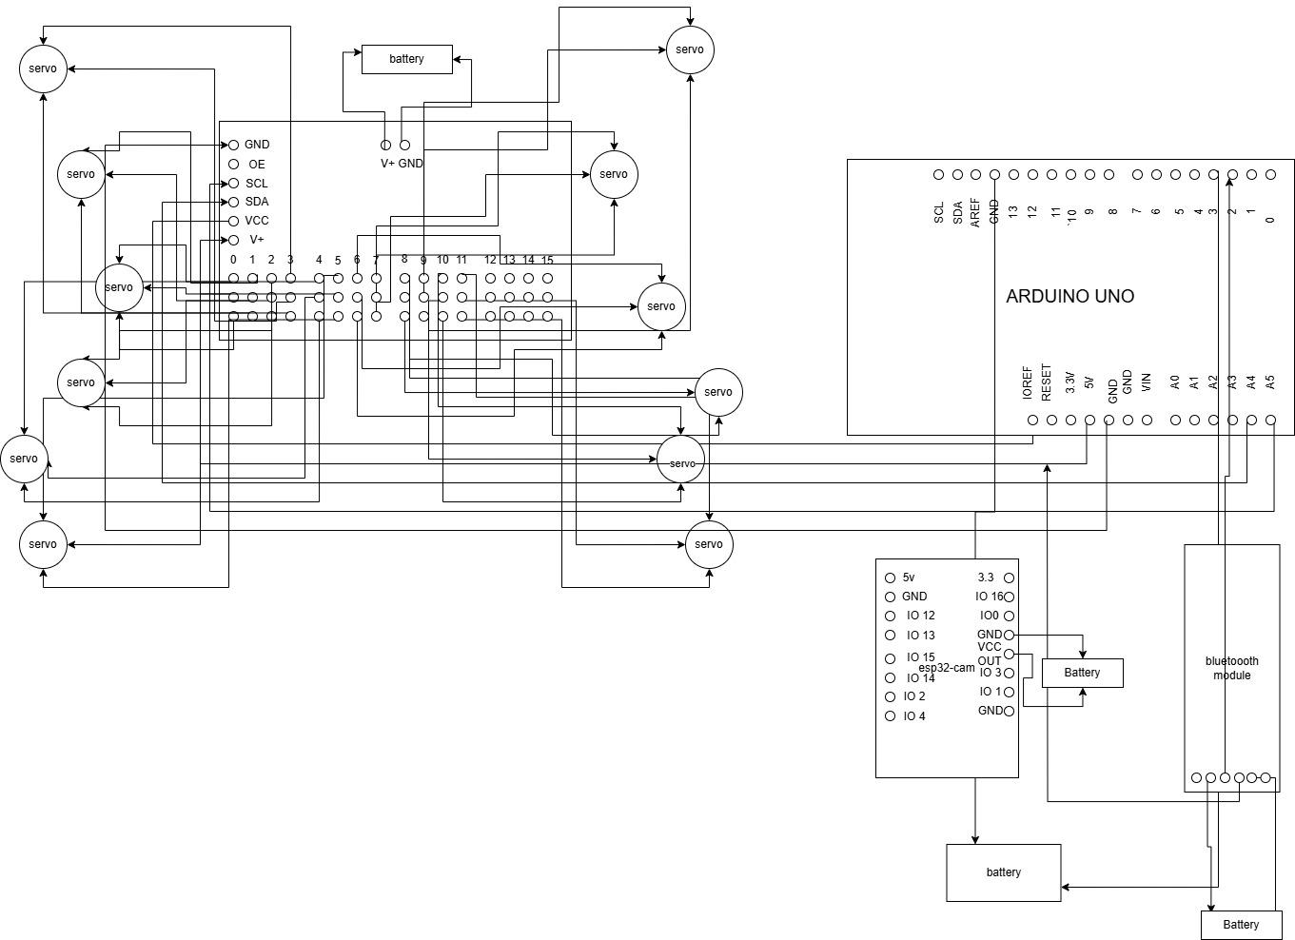
Electronic circuit diagram

Slide 11
Mathematics for BS2
Servo control
Speed control:
If speed*direction = 0 then θ = θ + speed
If speed*direction = 1 then θ = θ - speed
Squats:
If θ = θmin or θmax then reverse speed
Initialise all legs in same direction
Swagger:
If θ = θmin or θmax then reverse speed
Initialise legs in opposite direction
 | Min value | Max value
θ | -90 | 90
θn | 0 | 15
PWM | 500 | 1000

Slide 12
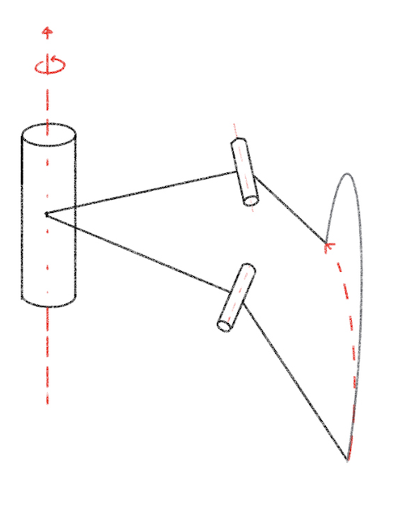
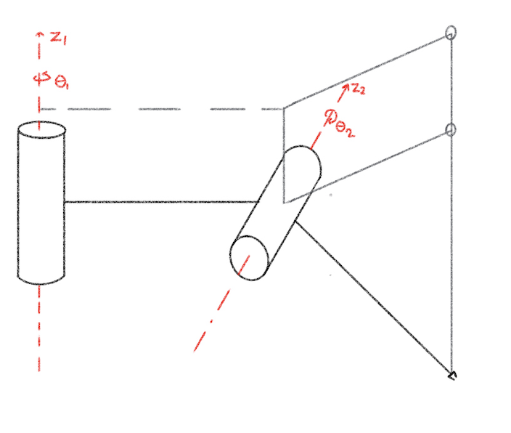
Working of hexapod
End Effector Coordinates:
𝑟 = 𝑎₁ + 𝑎₂𝑐𝑜𝑠(𝜃₂)
𝑙𝑜𝑐𝑎𝑙 𝜃 = 𝜃₁
𝛿 𝑧 = 𝑎₂ 𝛿 𝑠𝑖𝑛(𝜃₂)
Joint angle to Servo PWM signal:
𝑃𝑊𝑀 = (450/𝜋)*(𝜃-𝜋/2) +150

Slide 13
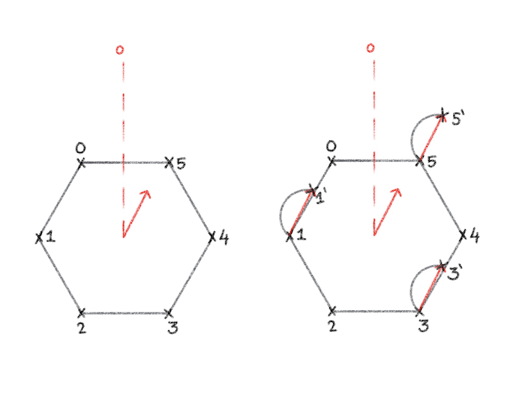
Gait algorithm
Group P : legs {1, 3, 5}
Group Q : legs {0, 2, 4}
1. P swing starts
2. Q assumes tripod
3. Q swing starts
4. P assumes tripod

Slide 14
Sensors, Actuators and Design
Microprocessors:
Arduino uno
BS-2 (Only for power)
Peripherals:
ESP32 with UV2640 cam
Bluetooth Module
Actuator:
9g micro servo
Lightweight and compact
Adequate torque
Design:
User control
Keyboard input for robot motion
Laptop to arduino communication over bluetooth module
Hexapod
12 DOF
Stability and flexibility
ESP32 Camera
Live stream of hexapod vision to user over internet

Slide 15
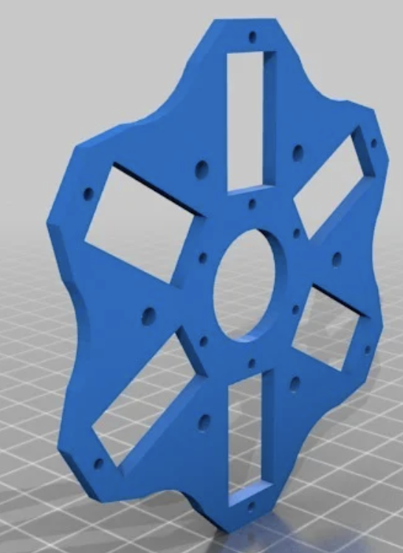
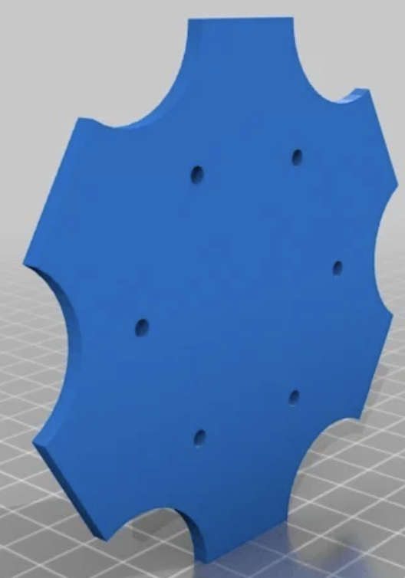
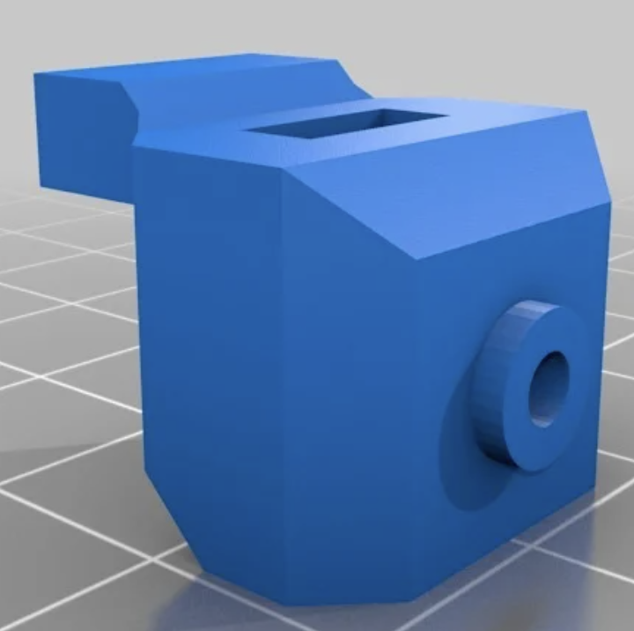
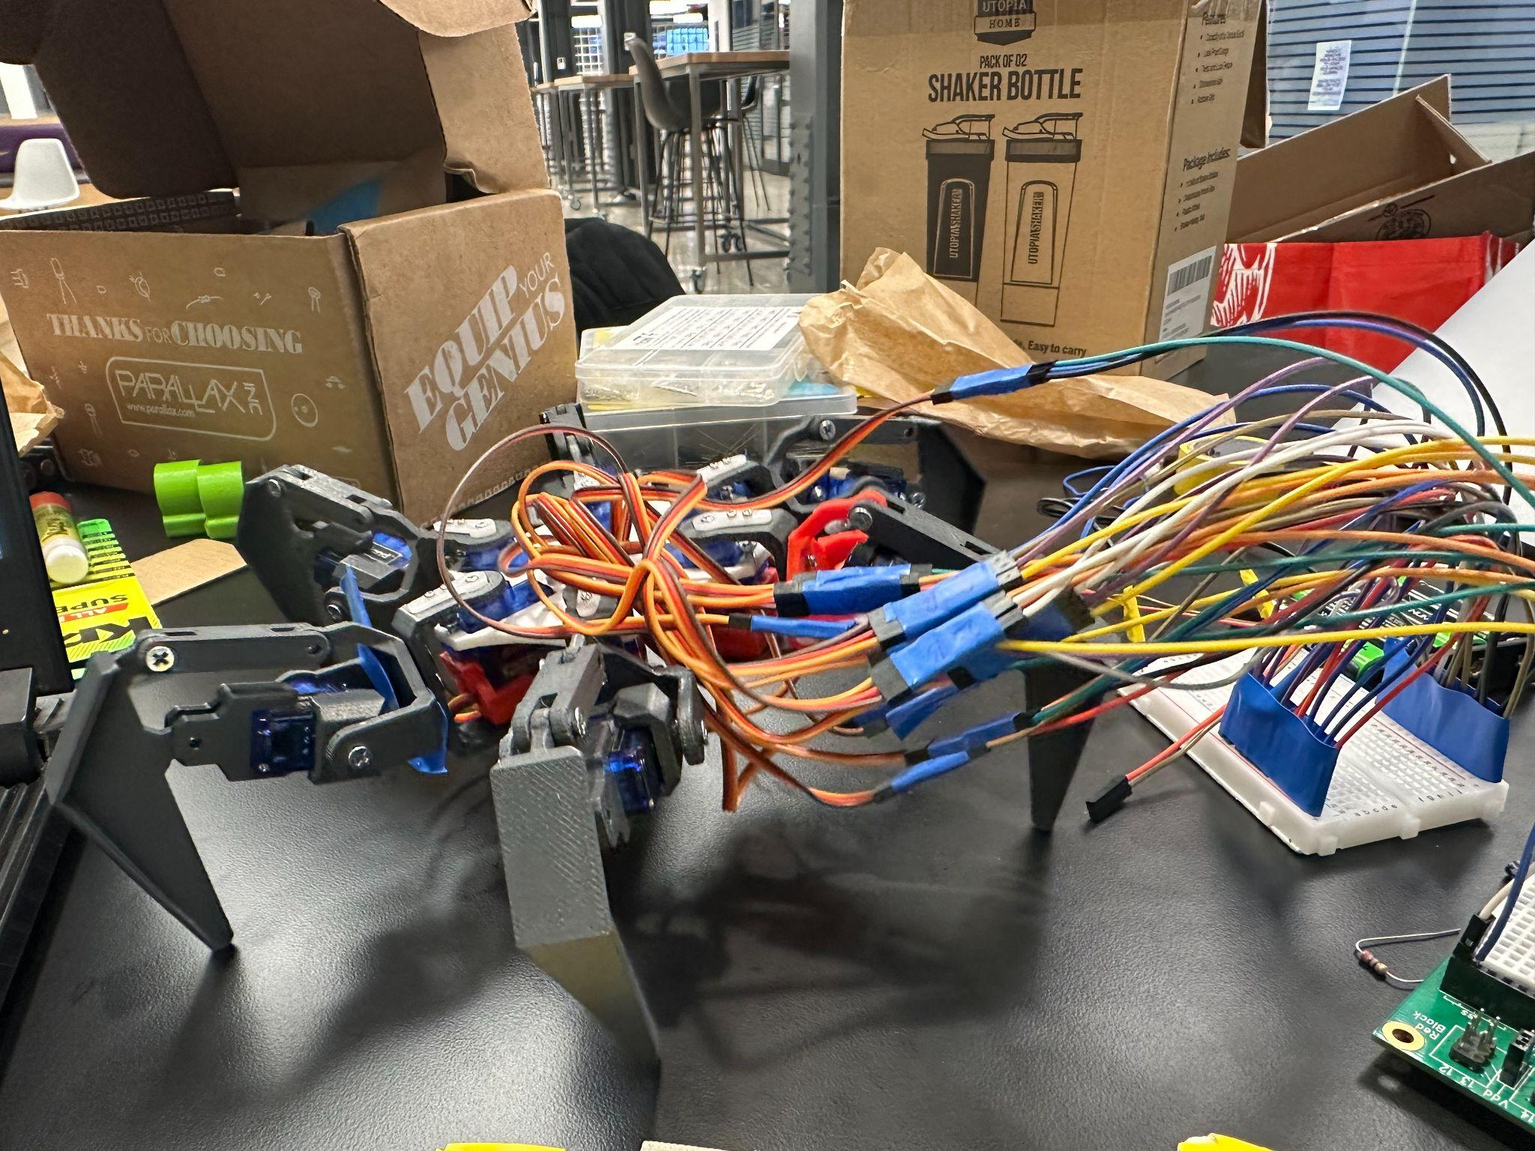
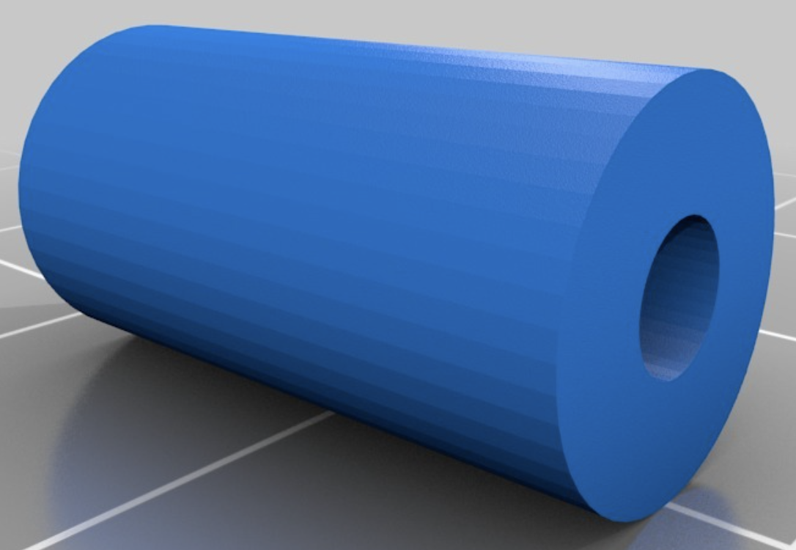
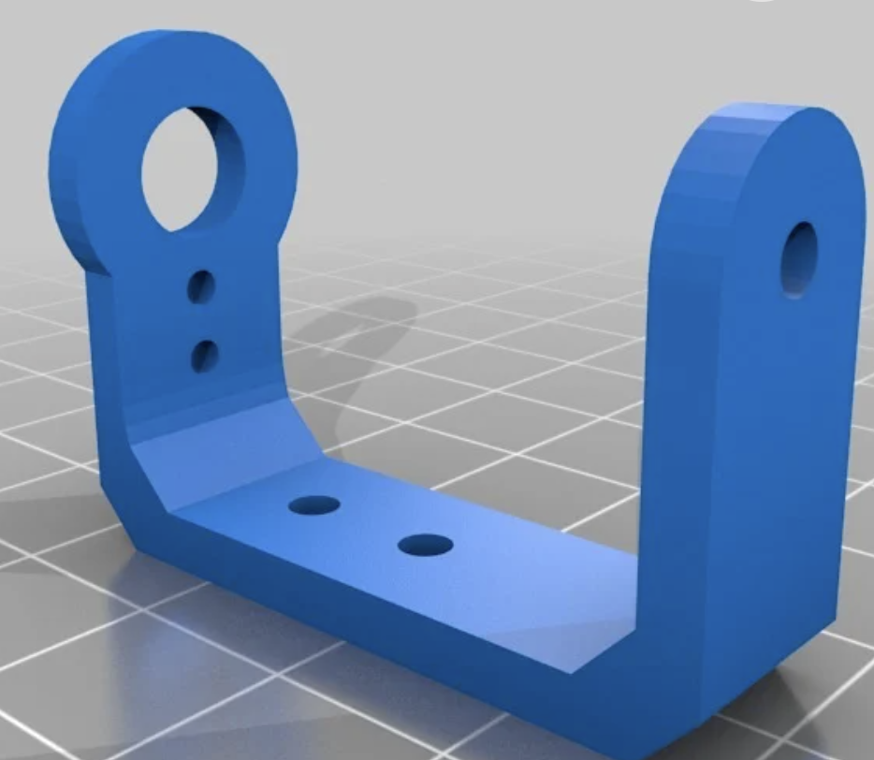
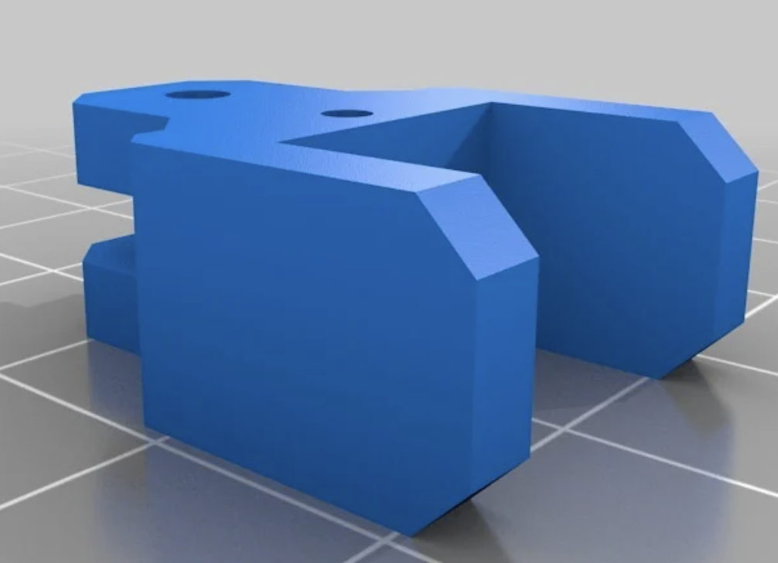
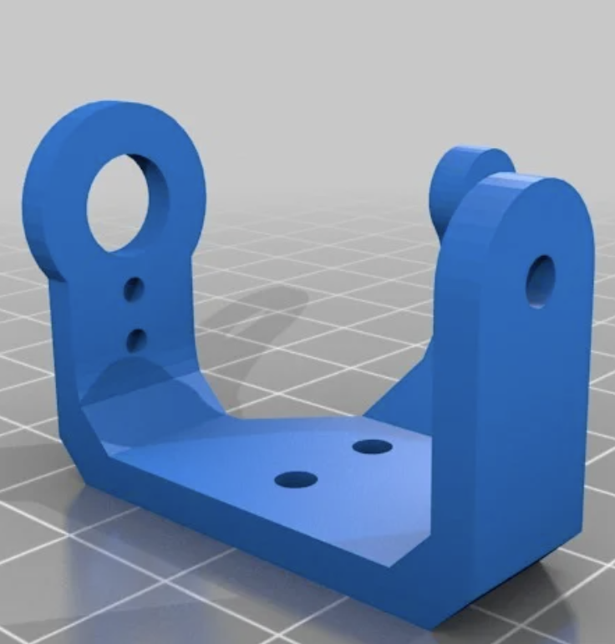
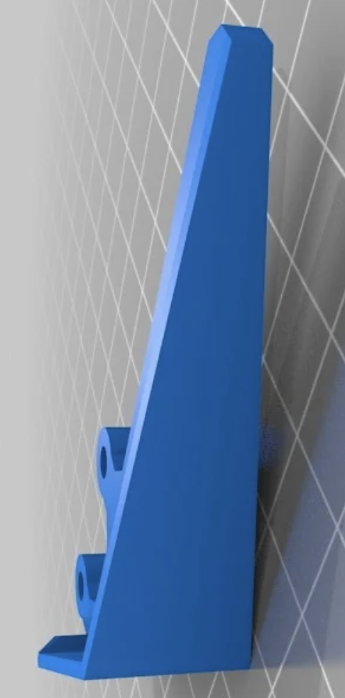
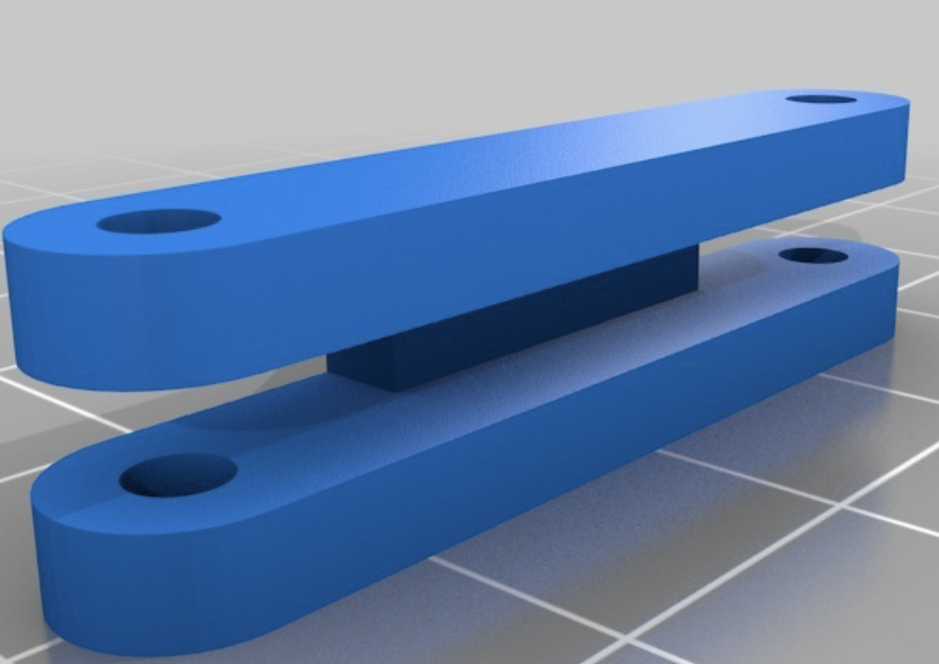
Mechanical Design - Hexapod
Supports
Hexapod
Lower base
Upper base
Servo Bracket
Leg Components

Slide 16
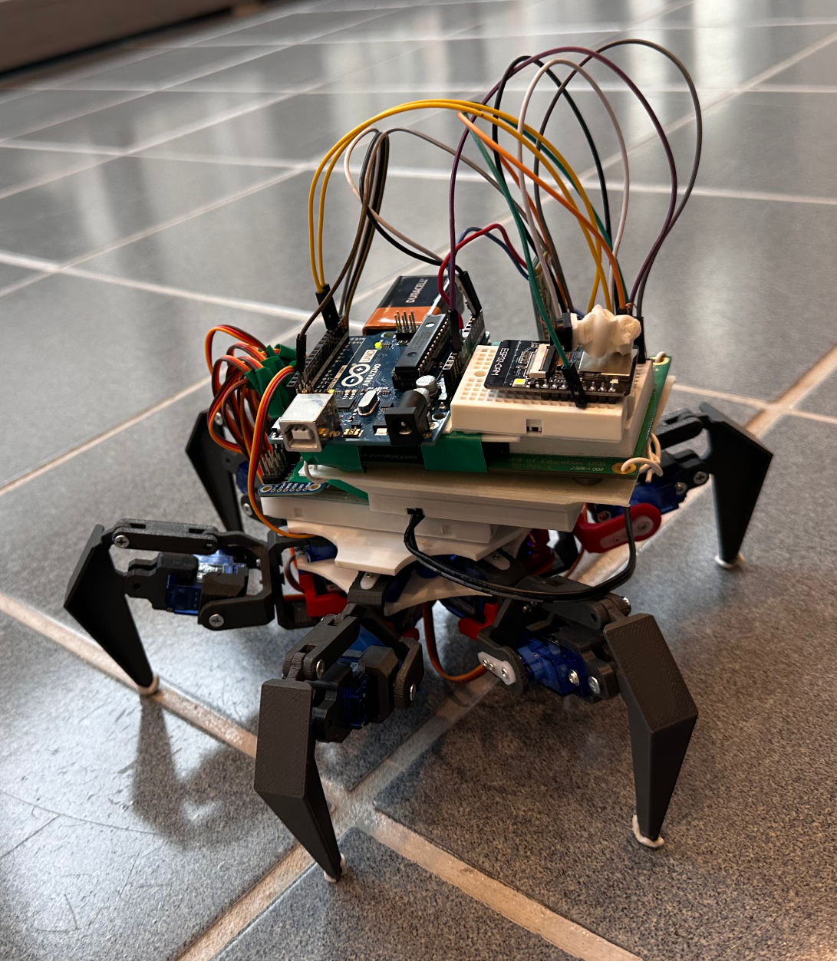
Hexapod integration
ESP32 Camera
AT-09 BT
BS2
Arduino uno
Servos

Slide 17
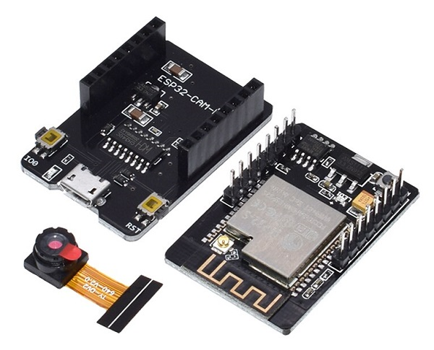
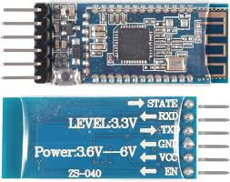
ESP-32 Camera
AT-09 BT module
ESP-32 Camera
AT-09 BT module
The ESP32 runs a lightweight HTTP server to stream images or live video.
Uses multipart MJPEG format to provide a continuous stream in a web browser
Brownout Protection: ESP32 has a brownout detector, which resets the device if power drops below the threshold.
Frame Buffering: Uses PSRAM (if available) to store images before sending them via WiFi.
Image Formats: Supports JPEG, RGB565, YUV422.
Python (pySerial, pynput) sends movement commands via serial communication over the AT-09 BT module
Arduino initialises the serial communication (SoftwareSerial) and reads the received data.
This data is used for hexapod control.

Slide 18
Code flow?
Encoder logic

Slide 19
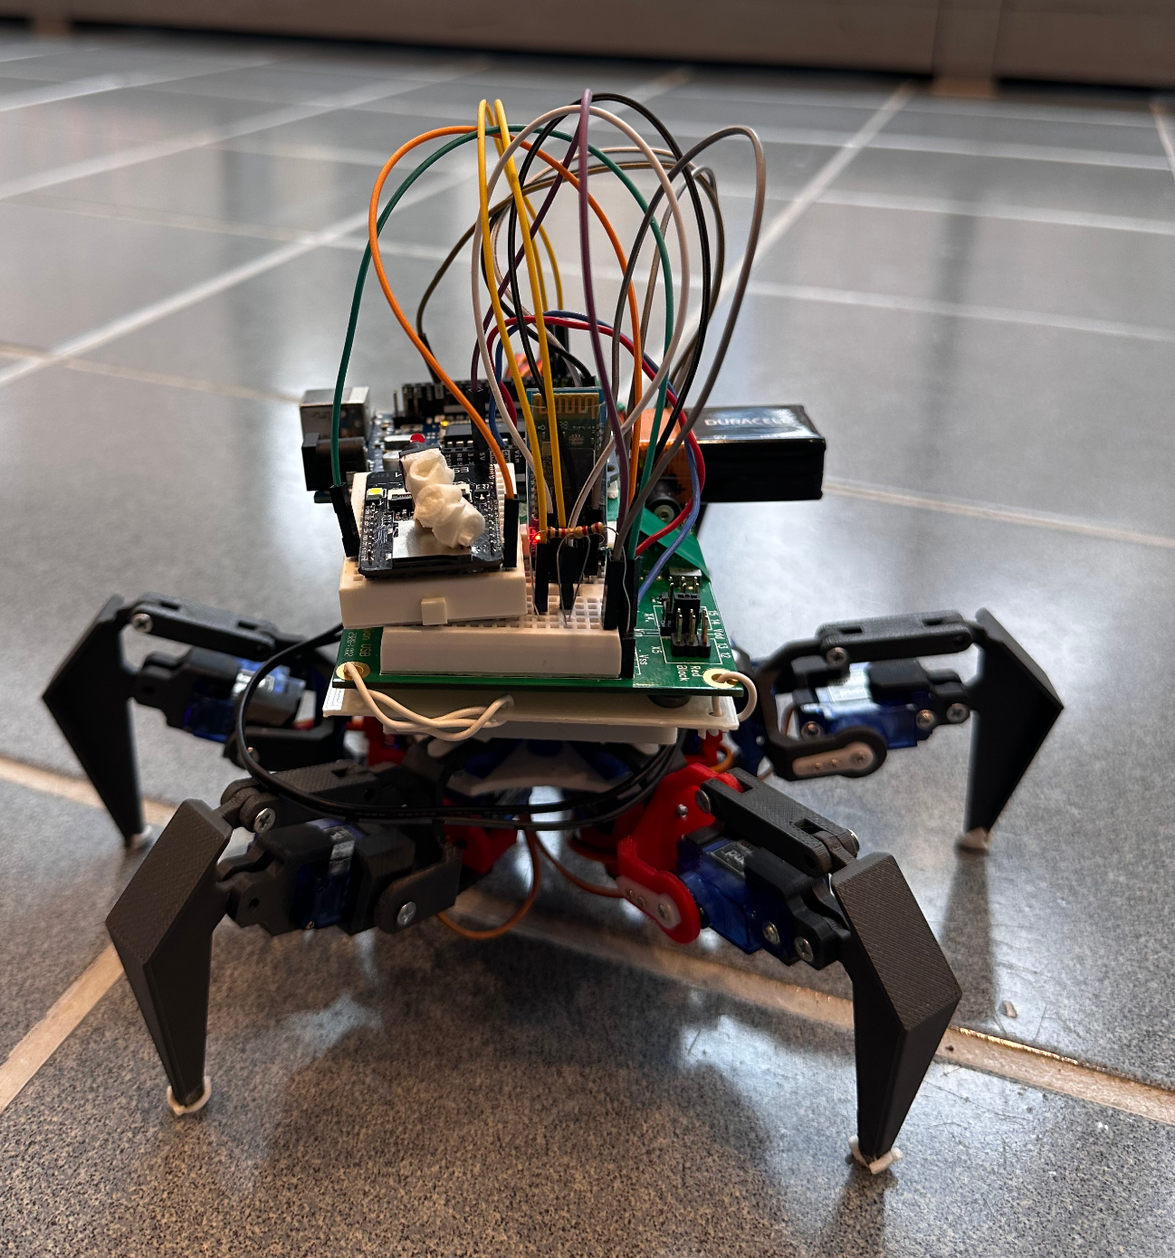
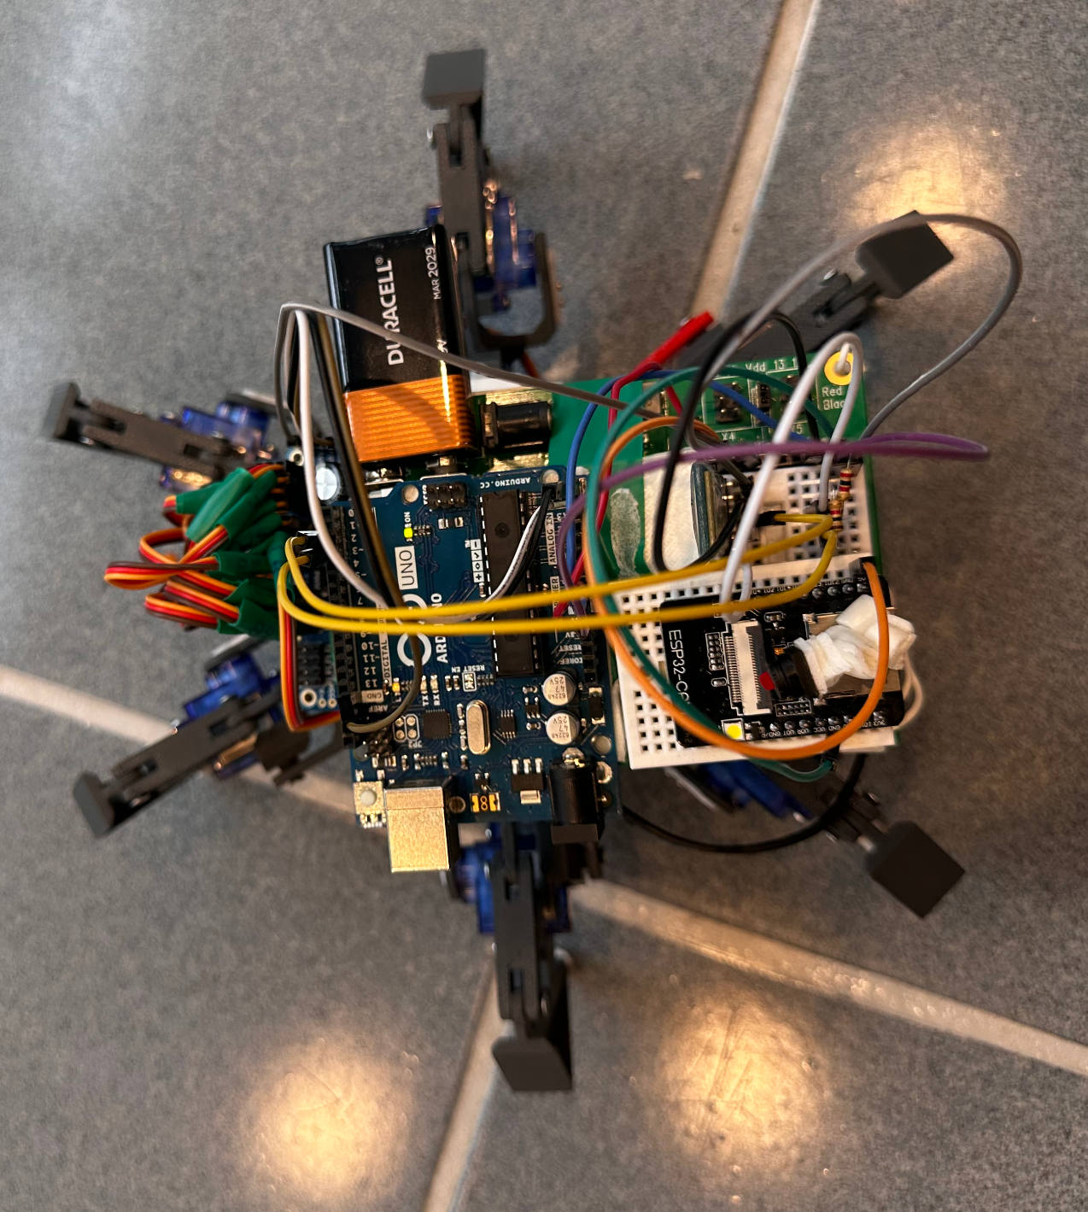
Final set up

Slide 20
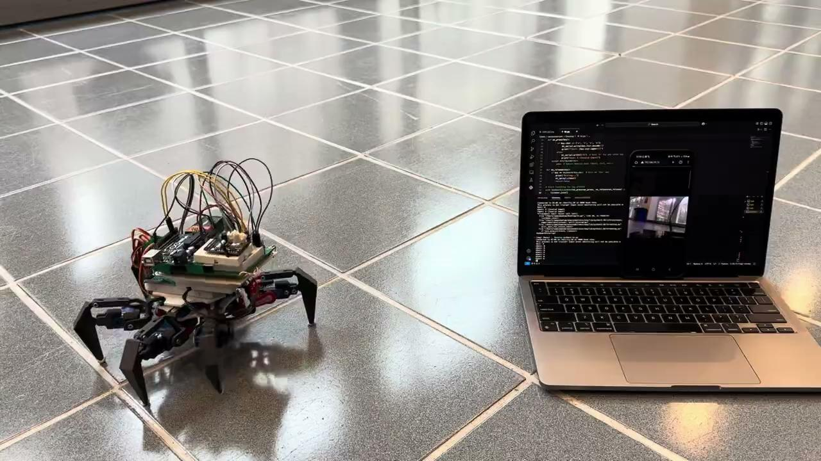
Prototype

Slide 21
Practical Overview

Slide 22
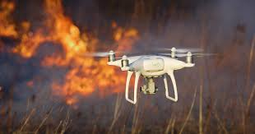
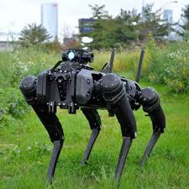
Related work
Several research efforts have been dedicated to enhancing search and rescue (SAR) operations through robotic innovations:
Autonomous Aerial Robots: Drones equipped with advanced algorithms can autonomously navigate disaster zones, providing real-time data to first responders.
Soft Robotics: Flexible robots inspired by biological organisms can adapt to complex terrains, improving navigation in hazardous environments.
Collaborative Multi-Robot Systems: Teams of heterogeneous robots, including ground and aerial units, work together to enhance efficiency in SAR missions.
Bio-Inspired Design: Robots with features modeled after animal physiology, such as moose-inspired hooves, demonstrate improved mobility in challenging terrains.
These advancements aim to address the limitations of traditional SAR methods, offering improved safety and efficiency in disaster response.

Slide 23
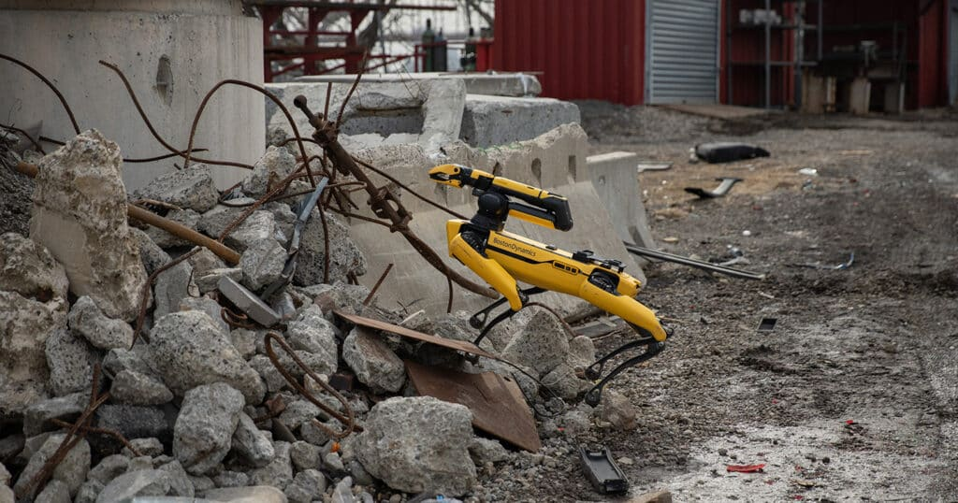
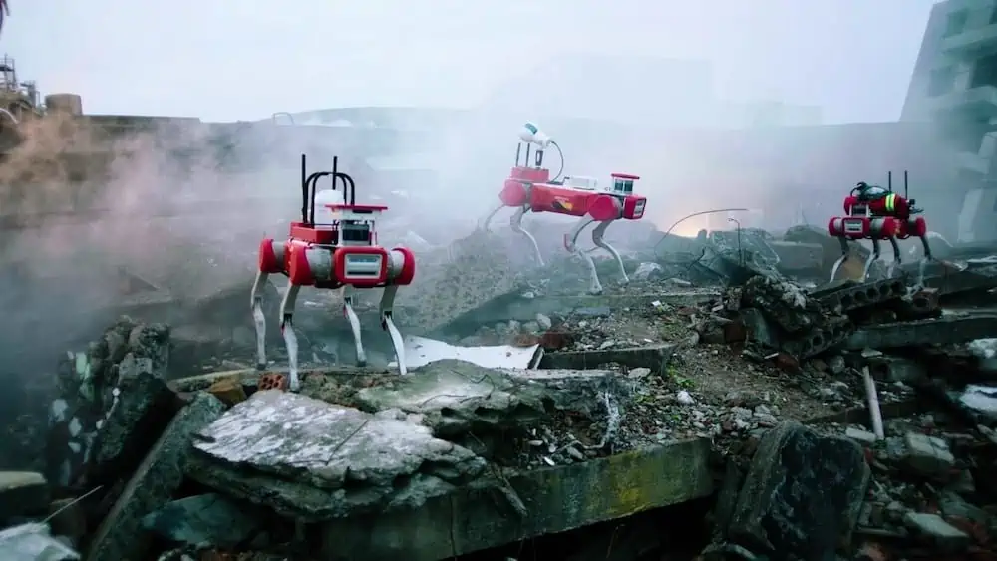
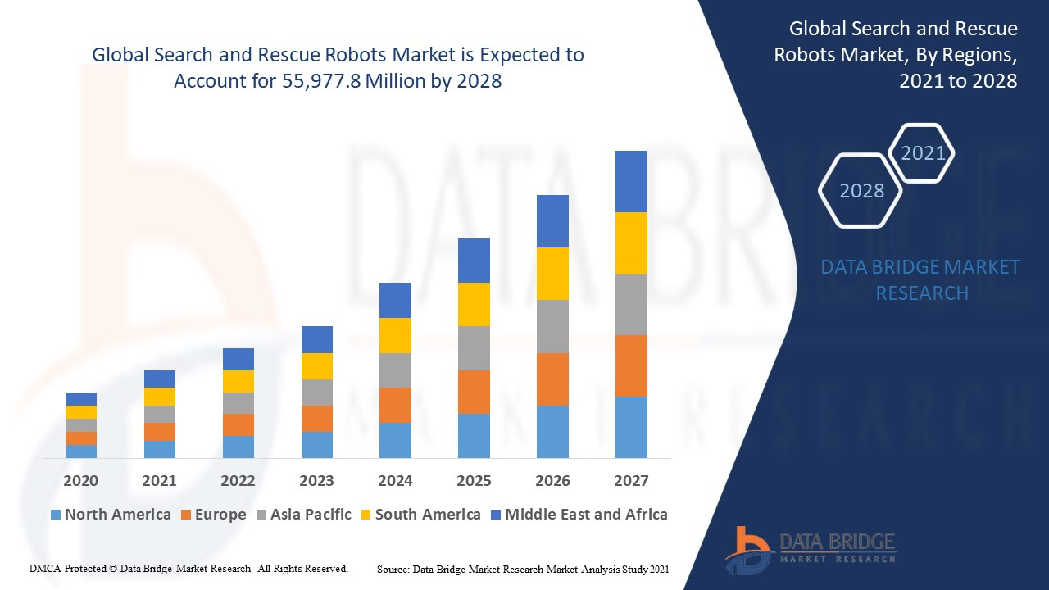
Applications
Innovative features and Unique selling proposition
Earthquakes
Floods
Wildfires
Industrial Accidents
Stability in rough terrain
Can reach places unreachable by humans
Wireless communication

Slide 24
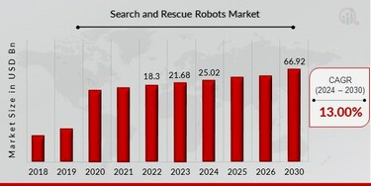
Innovative Features and Unique Selling Proposition
Innovative Features
Gesture based control for hexapod
User centric design
Unique Selling Proposition:
Expressive mobility
Customisable gestures

Slide 25
Cost analysis
Cost analysis for mass production
Cost component | Cost
Materials | $2,000
Actuators and sensors | $800
Manufacturing Labour | $500
Tooling | $100
Compliance and testing | $300
Marketing and distribution | $200
Shipping and Packaging | $100
Overhead | $300
Total | $4300
Advanced Wheelchair market price | $4365
Component | Cost
BS2 with Board of education | $100
9g Servo motors | $45
3D print | $14
Arduino uno | $30
ESP32 with camera | $10
Bluetooth Module | $10
Miscellaneous | $15
Total prototype cost | $224
Bill of Materials

Slide 26
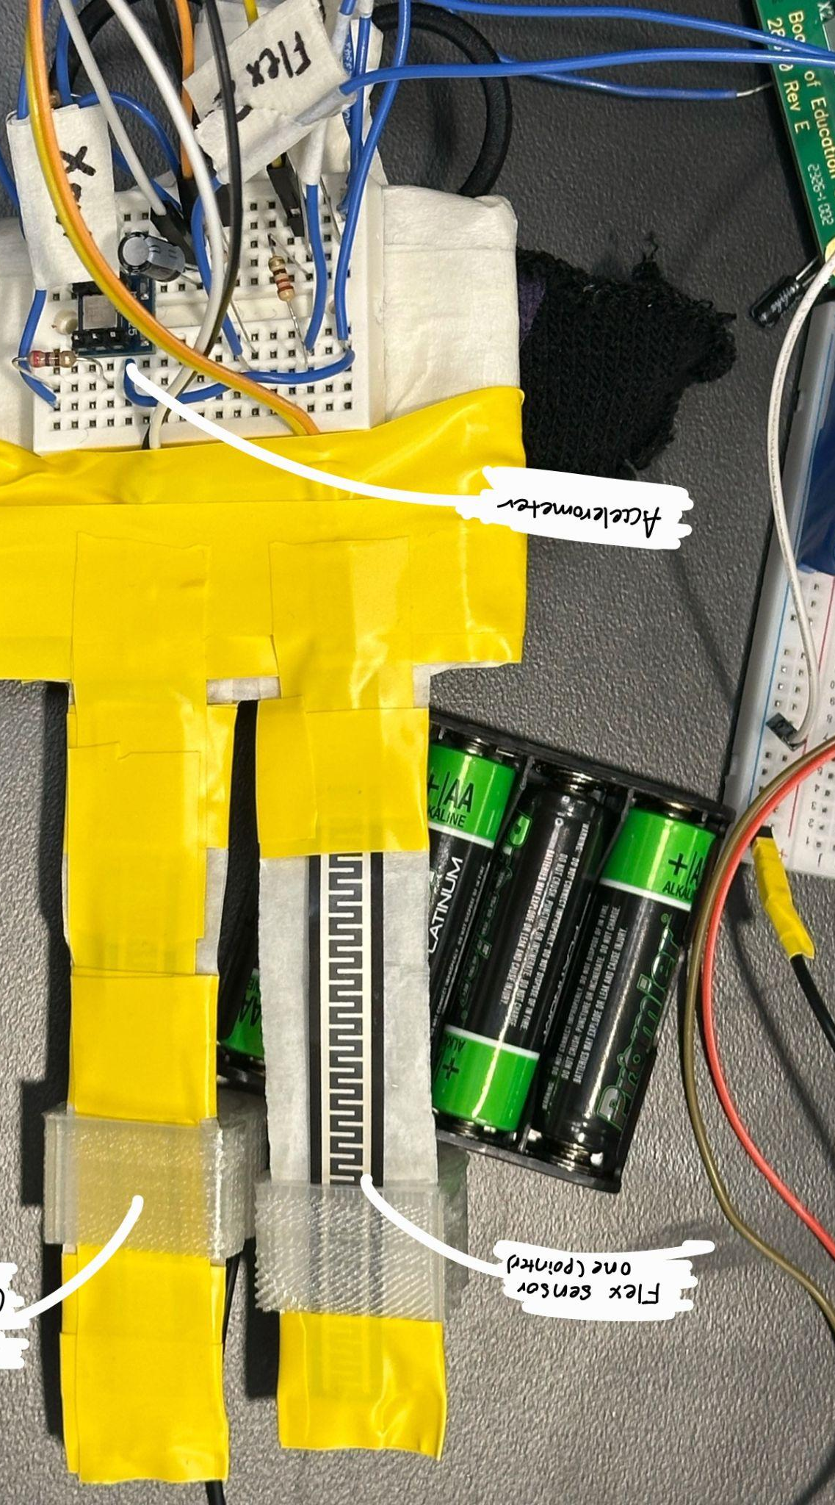
Next Steps
Integrate gesture control device to control hexapod movement
Make an 18 DOF hexapod for enhanced stability and added features
Incorporate more sensors for robot protection and rescue operations

Slide 27
Conclusion
Revolutionize Search and Rescue operations
Enhances disaster response
Scalable
Has versatile applications
Challenging with respect to system complexity and energy efficiency

Slide 28
References
https://ieeexplore.ieee.org/document/10434325
https://amprius.com/rescue-robots/#:~:text=Ability%20to%20access%20hard-to,victims%20in%20otherwise%20unreachable%20places.
https://www.marketresearchfuture.com/reports/search-and-rescue-robots-market-10599#:~:text=Search%20and%20Rescue%20Robots%20Market%20Size%20was%20valued%20at%20USD,period%20(2024%20%2D%202030).
https://randomnerdtutorials.com/esp32-cam-video-streaming-face-recognition-arduino-ide/
https://ieeexplore.ieee.org/document/7041375
https://groups.csail.mit.edu/robotics-center/public_papers/Posa13.pdf

Slide 29
Thank you.

